Slide 1
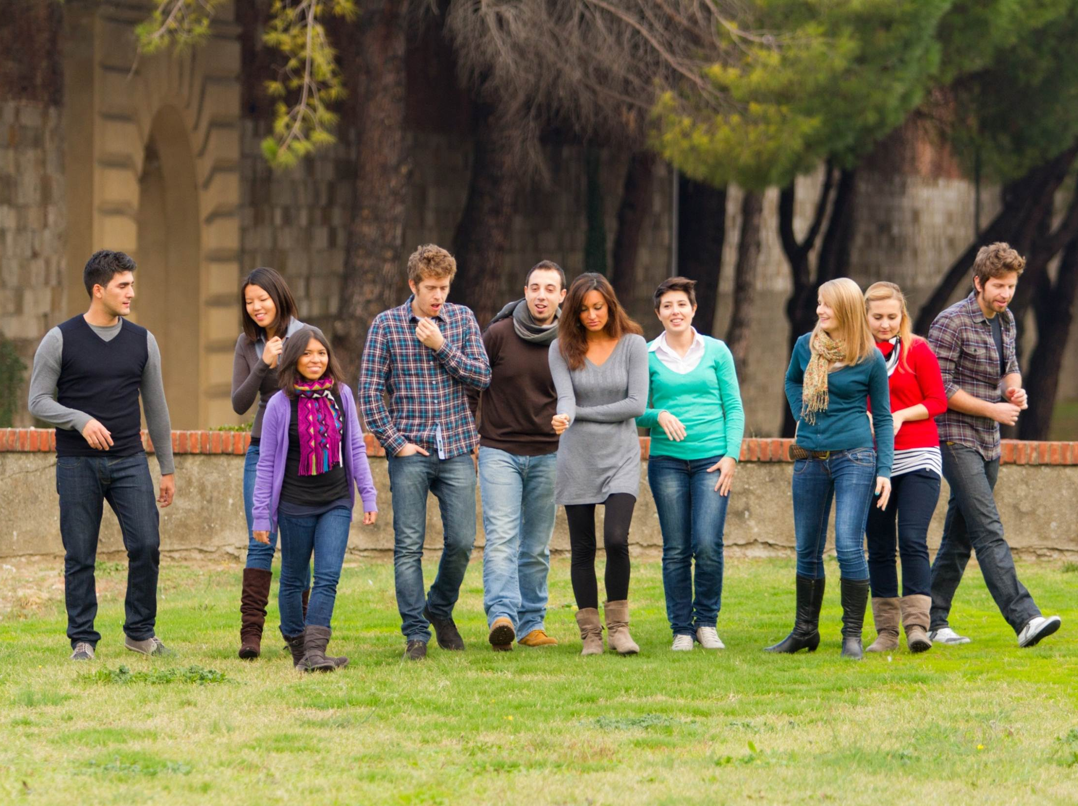
Interuniversity Learning in Higher Education on Advanced Land Management:
Egypt country
ILHAM-EC

Slide 2
Project description
Interuniversity Learning in Higher Education on Advanced Land Management:
Egypt country
ILHAM-EC
Luciano Gutierrez
Project coordinator, University of Sassari
Desertification Research Centre

Slide 3
Presentation overview
Desertification Research Centre
General Overview of Erasmus+
The Consortia
General overview of the project

Slide 4
PART I
Desertification Research Centre
GENERAL OVERVIEW
ERASMUS+ CAPACITY BUILDING

Slide 5
What is a Capacity-Building Project?
Aim: To develop new curricula and teaching methods.
Actors: Primarily Higher Education Institutions (HEIs) of EU Partner Countries and Program Countries.
Tasks: Working together, to develop, share and transfer best practices and innovative approaches in the fields of education and training.
Desertification Research Centre

Slide 6
ILHAM-EC SELECTION PROCESS
Desertification Research Centre

Slide 7
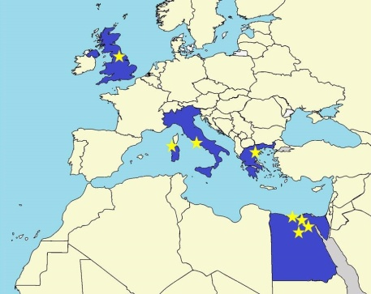
PART II
Desertification Research Centre
THE CONSORTIA

Slide 8
University of Alexandria
University of Cairo
University of Damanhur
University of Zagazig
PROGRAM EGYPT UNIVERSITIES
Desertification Research Centre

Slide 9
PARTNER HEIs & ASSOCIATES
EU Universities and other Partners:
University of Sassari - NRD
University of Leeds – School of Earth and Environment
University of Thessaloniki
UNIMED
ACS S.p.A.
Desertification Research Centre

Slide 10
PART III
Desertification Research Centre
GENERAL OVERVIEW
OF THE PROJECT

Slide 11
Why a new Master on
SUSTAINABLE LAND MANAGEMENT ?
Land Desertification and Urban pressure
Huge losses of productive land every year
More than 60% of food is imported
Several efforts by Egypt government to reduce desertification
Desertification Research Centre

Slide 12
MANAGEMENT
QUALITY CONTROL
Desertification Research Centre
WORKING PACKAGES
DISSEMINATION
E-LEARNING

Slide 13
Road Map for a new Master on SLM
Curriculum
Evaluation
Assessment
Start
Master
M
I
L
E
S
T
O
N
E
S
2016
2017
2018
Desertification Research Centre
E-Learning Modules
Training Teachers
Educational
Game
Mobility
Strand

Slide 14
TRAINING METHODS
INSTRUMENTS
VIDEO SCRIBING METHODS
INTERACTIVE E-LEARNING PLATFORMs AND EDUCATIONAL GAMEs
Desertification Research Centre
INSTALLATION OF WORKSTATIONS AND EQUIPS
UPDATING LIBRARIES

Slide 15
SCRIBING TECHNIQUES
Desertification Research Centre

Slide 16
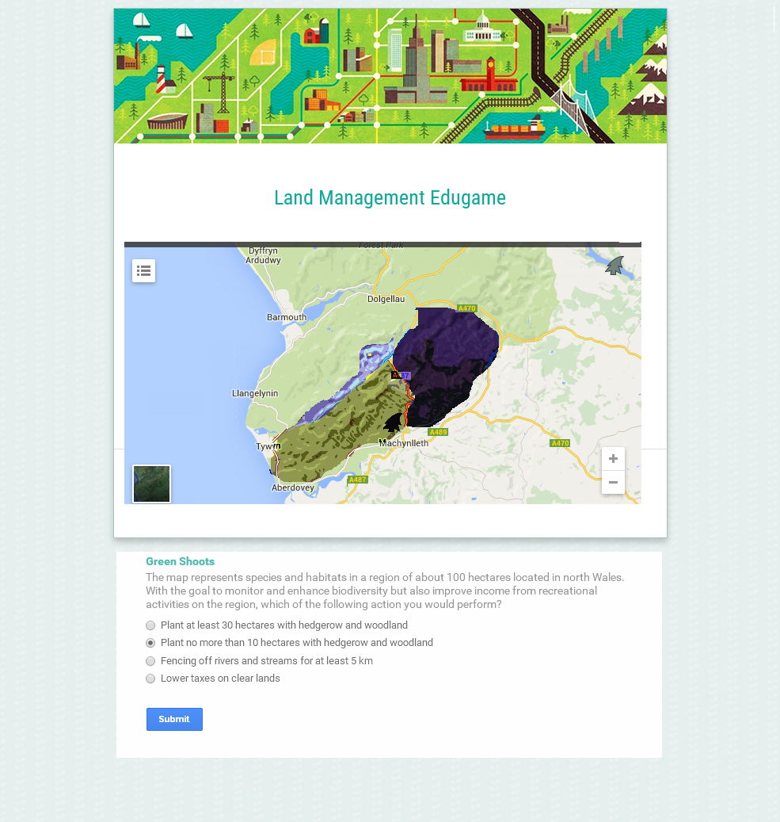
EDUCATIONAL GAME
Desertification Research Centre

Slide 17
INSTRUMENTS
Desertification Research Centre
INSTALLATION OF WORKSTATIONS AND EQUIPS
UPDATING LIBRARIES

Slide 18
Mail : ilham.ec@uniss.it
Desertification Research Centre
Web : ilham-ec.uniss.it

Slide 19
Desertification Research Centre

